Slide 1
The Zen of Coding
Notes:
6:30-7:00

Slide 2
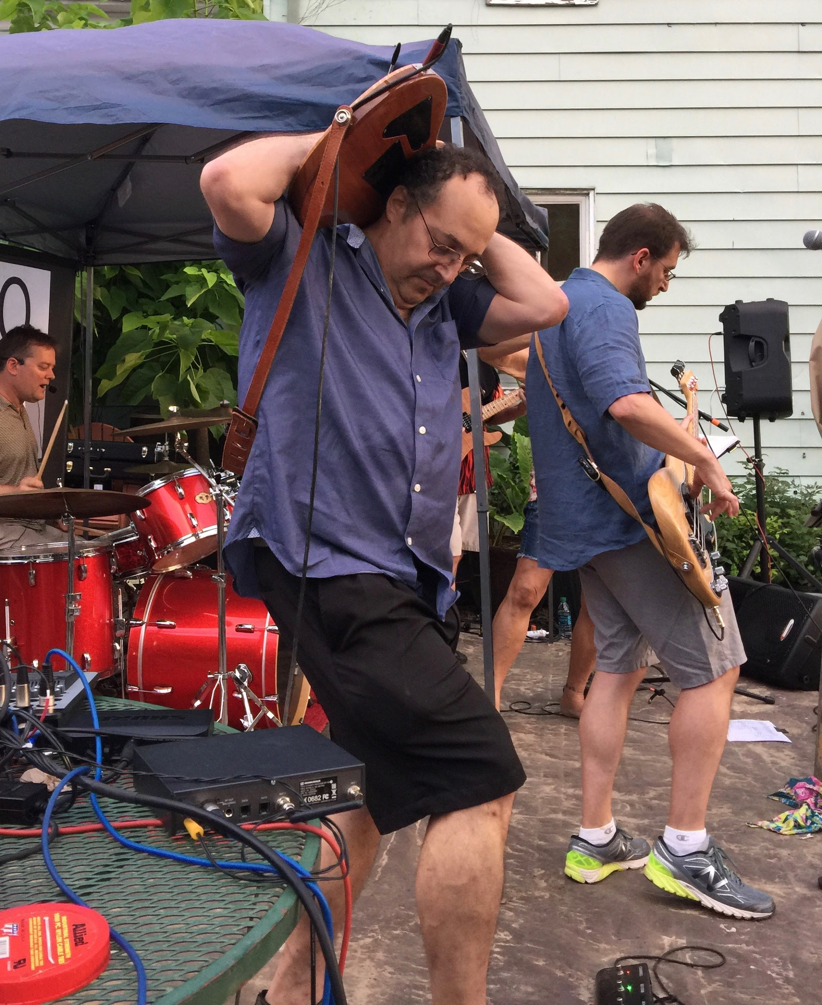
Eric Newman
Worked on the Space Shuttle
Wrote the Destruct System code
Helped create the internet
AOL, Match.com, MapQuest, Etc.
CURRENTLY Work at a Mobile Startup AS VP OF R&D
Insatiable Coding Junkie
I Eat mobile web apps for breakfast-
Band Leader & Guitar Player...
Notes:
7:00-

Slide 3
Your Turn = Go!
Who are you?
Where are you from?
What’s your background?
Why are you here?
Fun fact?
Notes:
-7:29

Slide 4
The Path of Learning
Notes:
7:15 We’re here to teach you how to teach yourself.

Slide 5
Goals
Notes:
7:15

Slide 6

Lifelong Learning
Everything is in motion - Progress and evolution OCCUR every day...
Notes:
7:16

Slide 7

What is Code?
Notes:
7:17

Slide 8
The Keys to Success
Notes:
7:17

Slide 9
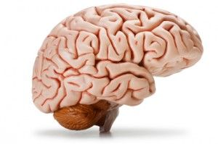
Mindset
Remember this all came out of human brains like yours...
Notes:
7:18

Slide 10
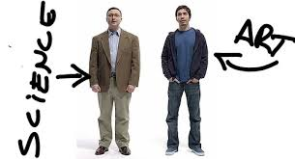

Creativity and Intuition
Don’t forget that this is as much Art as it is Science… You need BOTH halves of your brain to be successful...
Notes:
7:19 How many play an instrument, paint, write or have creative hobbies

Slide 11
Teamwork
...Divide and conquer...
Notes:
7:20

Slide 12
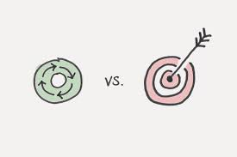


Focus
It does get easier...
Notes:
7:22

Slide 13

Google Fu
Sharpen your search skills… Don’t forget judgement.. Learn who to trust...The internet isn’t always right about YOUR problem or situation...
Notes:
7:24

Slide 14
SOLUTIONS!
Innovation
Creativity
Teamwork
GoogleFu
…… Voilá
Notes:
7:25

Slide 15
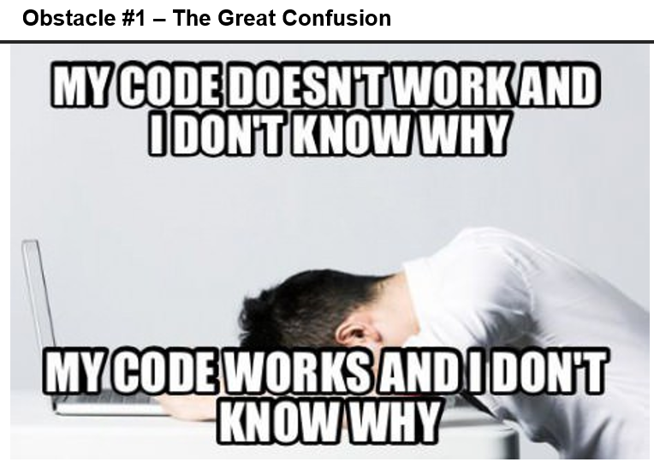
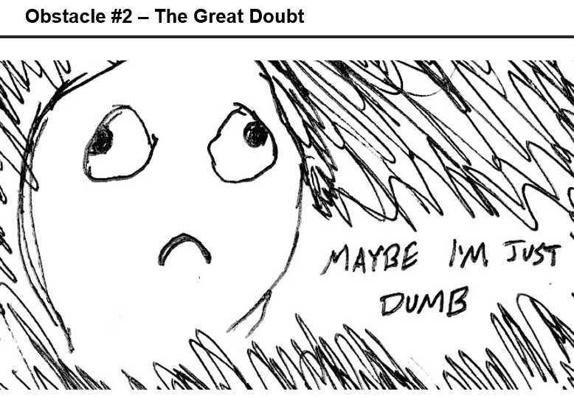
Dillemas!
We are here to help you, but only if you engage us to help!
We’ve been there!
Coding is hard. It will take time. There is no way around that.
Slack your Team, Office Hours, TA’s, GoogleFu -- We will get you through it!
Notes:
7:26

Slide 16
Course Structure
Notes:
7:30

Slide 17
Daily Schedule
Set objectives
Lecture
Demo(s)
Discussions
In-class exercise
Homework and projects
Notes:
7:31

Slide 18
Weekly Schedule
Homework
AND/OR
Project (Individual or Group)
Notes:
7:32

Slide 19

Learning to Code Requires Coding
You will never stop getting better...
Notes:
7:34

Slide 20
Pre-Work
Notes:
7:35

Slide 21
Checklist
Slack
Atom or Sublime Text 3
Git
CLI
Git Bash (Windows)
Terminal (Apple)
Node.js
Heroku
Chrome
Notes:
7:40

Slide 22
WORKING Accounts
GitHub
GitLab
Heroku
Stack Overflow
LinkedIn
Notes:
7:45

Slide 23
Test
Open Sublime
Open Git Bash or Terminal
node -v
git --version
heroku --version
Notes:
7:50

Slide 24
Break
Notes:
8:10

Slide 25
The Modern Web...
Notes:
8:25

Slide 26
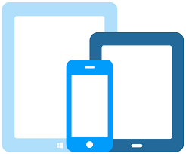
Full Stack Magic?
Notes:
8:26

Slide 27
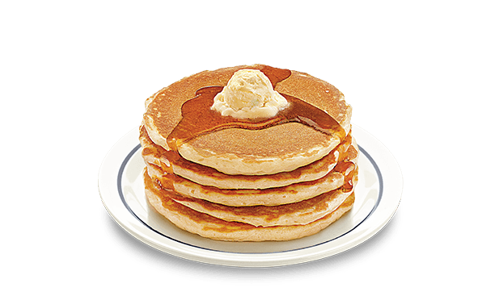
What is Full Stack Development?
Page Stuff - HTML, CSS
Data Stuff - MongoDB, MySQL, Firebase
Logic Stuff - JavaScript, Node.js, PHP, Etc.
Frameworks - Angular, React, Vue, Etc.
Notes:
8:27

Slide 28
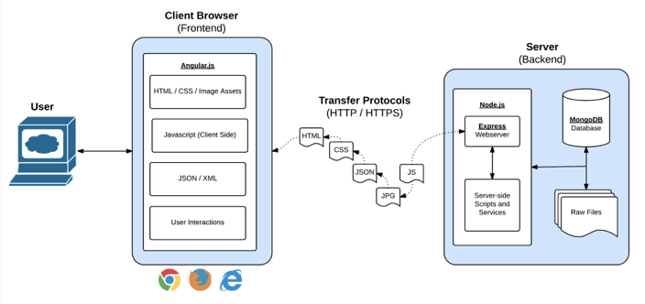
Front End, Meet Back End. Back End, Front End.
Notes:
8:28 In modern web apps, there’s a constant back-and-forth communication between two key components: the visuals displayed on the user’s browser (frontend) and the data and logic stored on the server (backend).
Full-Stack Development is the concept of building every aspect of the web application – from the visuals and interactions, to the data transfer and processing.

Slide 29
Building Blocks
Every tool, language, command, script, app, and technology adds another set of cool blocks waiting to be combined, and explored in new ways...
Notes:
8:30

Slide 30
In the Beginning was
the Command Line...
Notes:
8:33

Slide 31
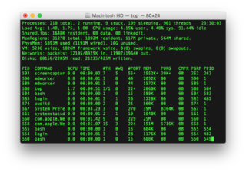
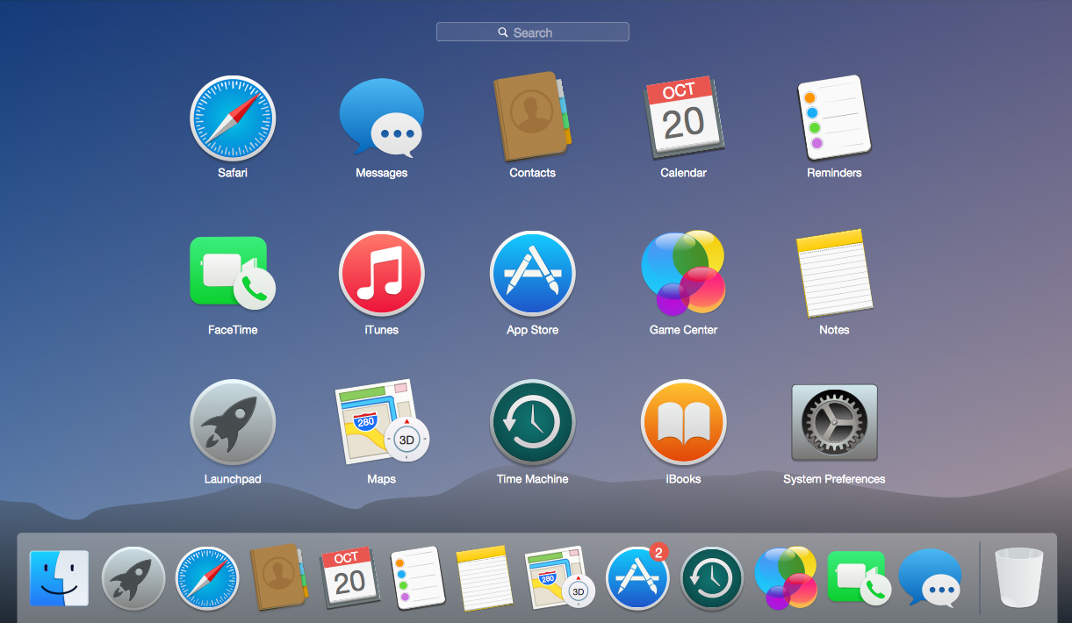
CLI vs. GUI
Notes:
8:33

Slide 32
Files
touch
ls (list)
open (Apple), explorer (Windows)
cat (concatenate)
rm (remove)
Notes:
8:34

Slide 33
Editing Tools from CLI
subl --help,
Usage: subl [arguments] [files] edit the given files
or: subl [arguments] [directories] open the given directories
or: subl [arguments] - edit stdin
OR
atom --help
Usage: atom [arguments] [files] edit the given files
or: atom . (opens folder)
or: atom file.js (opens file)
or: atom (opens editor)
VIM : not today!
Notes:
8:35

Slide 34
Directories
pwd (print working directory)
mkdir (make directory [folder])
cd (change directory)
cd .. (move up)
cd ~ (go home)
open . (Apple), explorer . (Windows)
rm -r (remove directory)
Notes:
8:38

Slide 35
Special Keystrokes
Esc
Control-C
Tab
Up/Down
Notes:
8:39

Slide 36
RTFM
man
which
help -?
Notes:
8:40

Slide 37
Go!
From the command line:
Make a new directory titled: first_day_stuff
Change into directory first_day_stuff
Create a file titled: first-day.html
Open first_day_stuff
Bonus
In one command, make multiple directories titled: dir_one and dir_two
In one command, create multiple files: one.html and two.html
Notes:
8:43

Slide 38
Find a Friend
Friend on the right, explain:
How to make a directory
How to change into a directory
How to create a file
How to open directories and files
Friend on the left, answer:
What is Full Stack Web Development?
Notes:
8:55

Slide 39
Hello, HTML!
Notes:
9:00

Slide 40
Go!
Create my-first-web-page.html, and include the following:
DOCTYPE declaration
head tag with a title tag
h1 tag with a heading of your choice
Embed an image
Add three links:
One standard
One that opens in a new tab
One that is a bold placeholder
Bonus
Use an alternative way of separating links without line breaks
Create an ordered list of steps to make a sandwich
Create an unordered list of 5 of your favorite bands
Embed a YouTube video of one of your favorite songs
Notes:
9:05
Open the file my-first-html-with-bonus.html, and walk students through the solution. As you discuss the solution, be sure to point out the following:
Key elements like <!DOCTYPE html>, <html>, <head>, <h1>, the links.
Good indentation practices. In fact, if you have time, unindent everything by highlighting everything and hitting ctrl-j and then re-running the code. Explain that the code will still work but that it's awful to read and maintain. Build good practices now!
Give students a few moments to ask questions.

Slide 41
Solution
Notes:
9:10

Slide 42
Supplemental Videos
Notes:
9:20

Slide 43
Homework
Review
my-first-web-page.html
Watch the HTML video (see Slack for link)
command line
git commands

Slide 44
Have a Great Night!
Notes:
9:30

